Slide 1

An automated approach for the classification of Covid-19 and pneumonia patients from chest X ray images using LSTM based models.
Project & Thesis-II : CSE 4250
Presented by Group 3913
01

Slide 2





Meet The Group
Faiza Anan Noor
Ishrakul Munzerin
A.M Asif Iqbal
Tanima Islam
Mr. Emam Hossain
Supervised by
Assistant Professor, Department of CSE
Ahsanullah University of Science and Technology
02

Slide 3
01
Introduction
02
Literature Review
03
Methodology
04
Result Analysis
The Contents
05
Future Directions
06
Conclusion
07
References
08
Appendix
03

Slide 4

Introduction
COVID-19 pandemic
Assist doctors to ease out their burdensome task
04

Slide 5
Motivation & Objectives
Slow and Inaccurate Results
High cost and unavailability of medical kits
Too much workload
Absence of trained staff
Human Prone Errors and Risk Factors
05

Slide 6
Literature Review
06

Slide 7
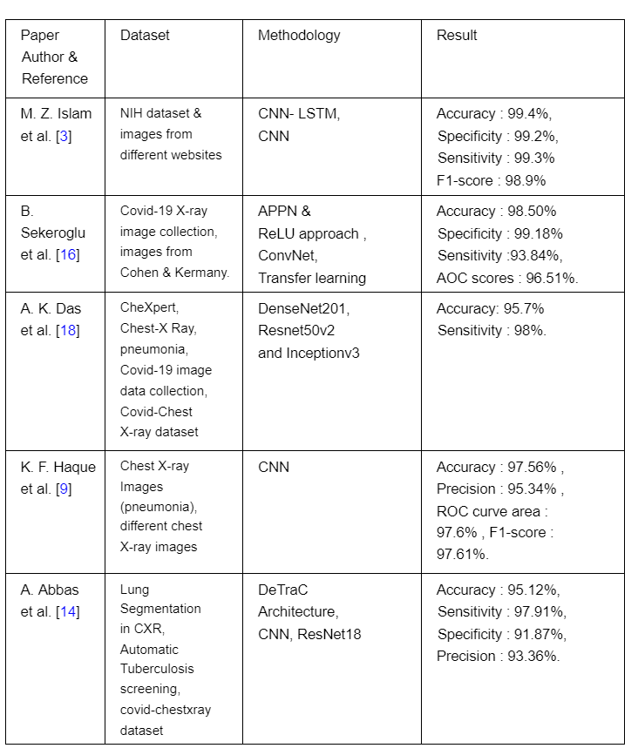
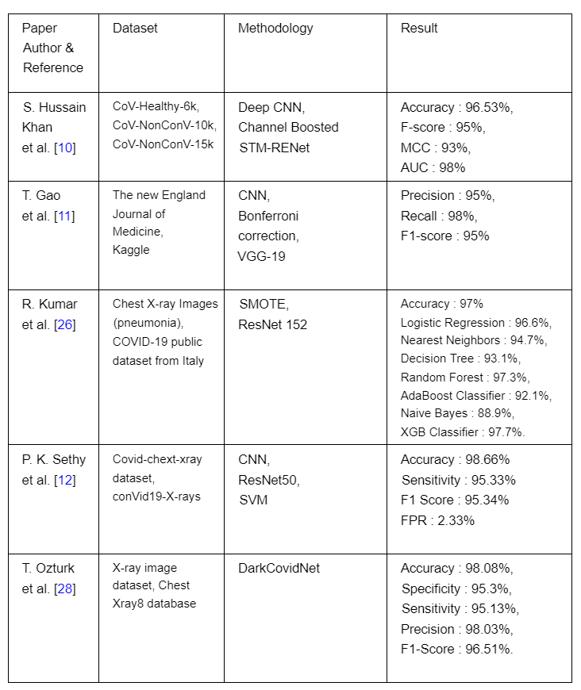
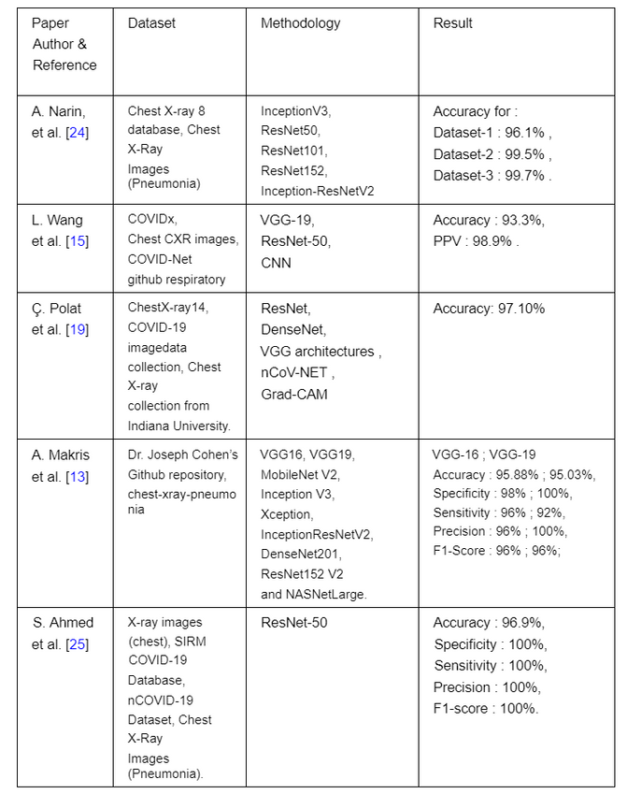
Summary of Related Works
07

Slide 8
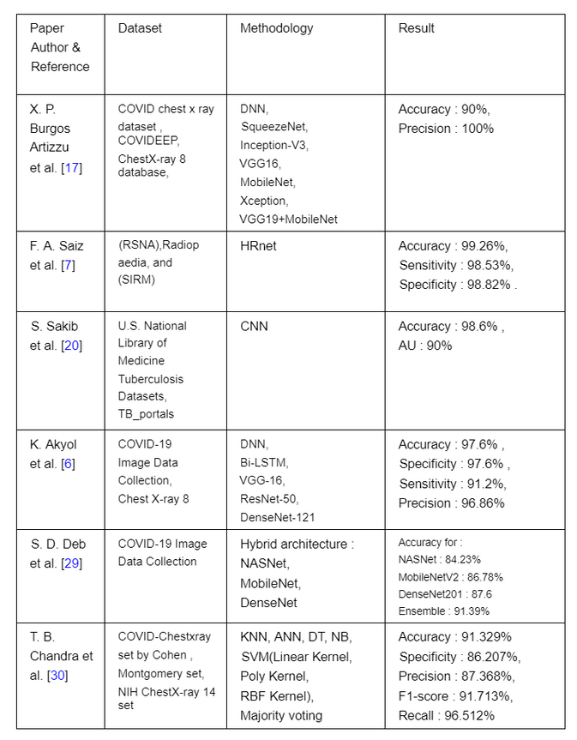
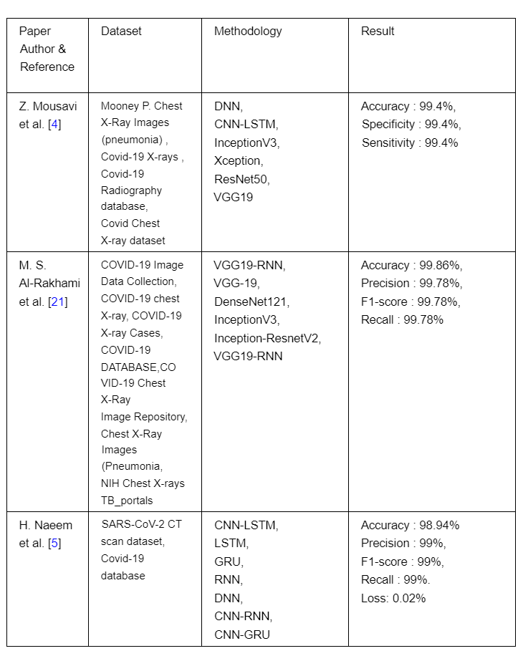
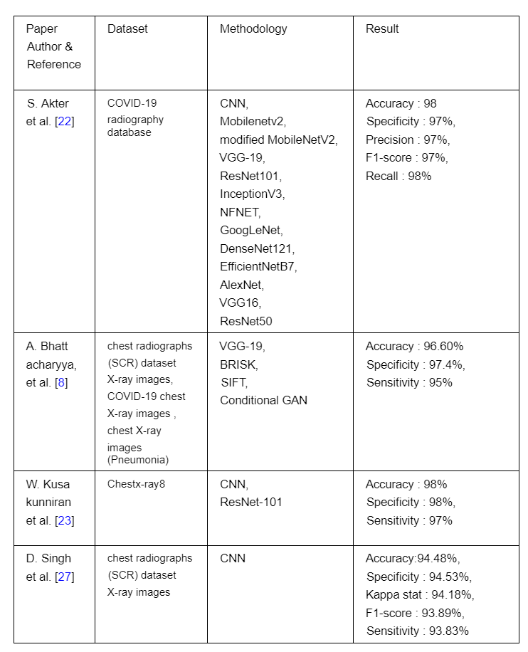
Summary of Related Works
08

Slide 9
Methodology
09

Slide 10

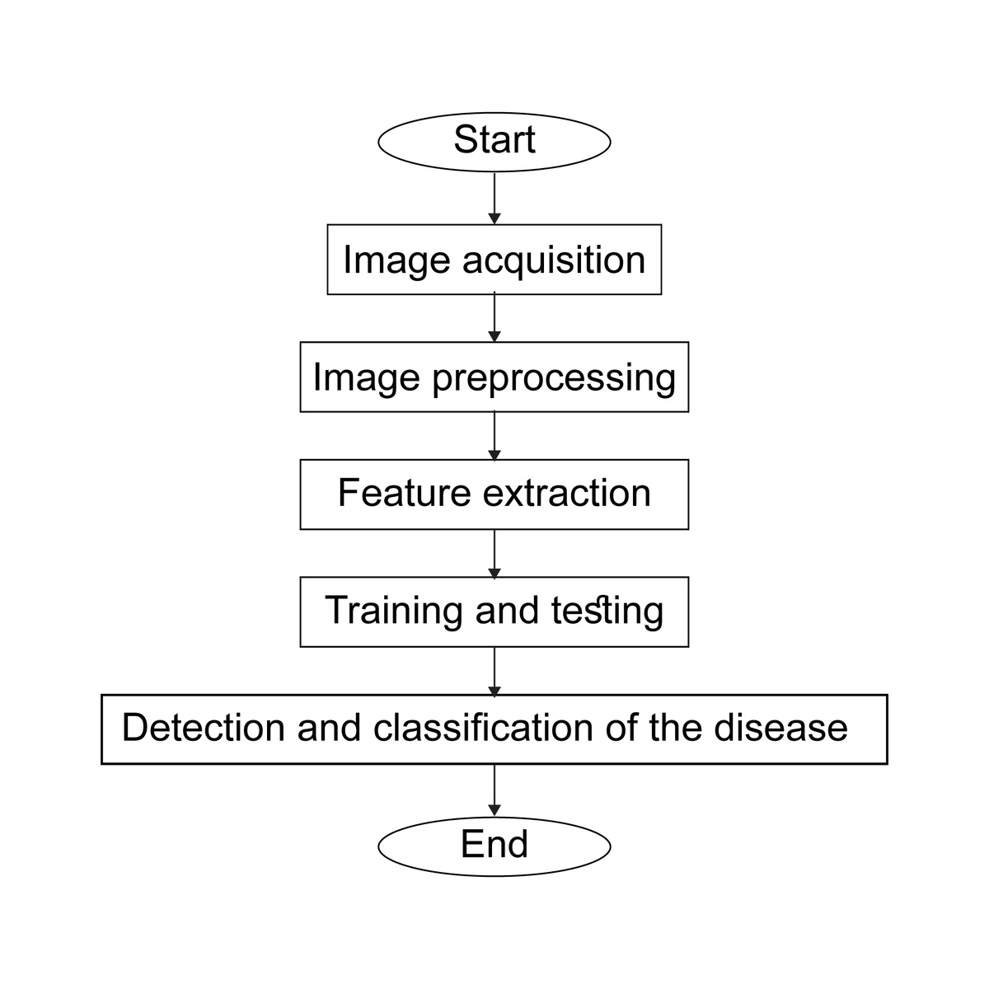
Methodology
Work Flow of our system
10

Slide 11
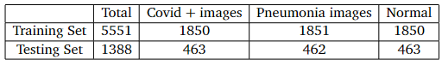
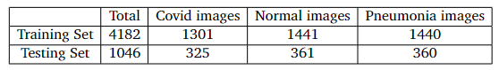

Methodology
Datasets Collection
Dataset 1 (Primary Dataset) : COVID19_Pneumonia_Normal_Chest_Xray_PA_Dataset
TOTAL: 6939
Dataset 2 (Secondary Dataset) : COVID19_Pneumonia_Normal_Chest_Xray_Images
TOTAL: 5228
Training : 80%
Validating : 20%
Testing : 20%
11

Slide 12
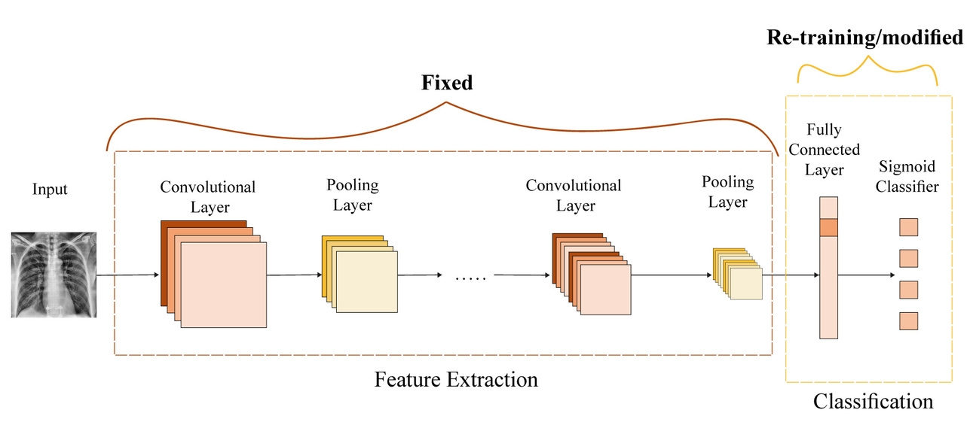
Methodology
Tools Used
Image Preprocessing and Augmentation
Convolutional Neural Network (CNN)
Transfer Learning
12

Slide 13
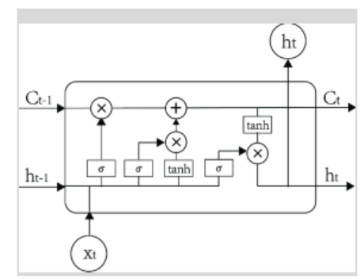
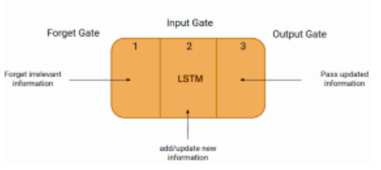
Methodology
Reference Models of Experiment 1
01
CNN-LSTM
13

Slide 14
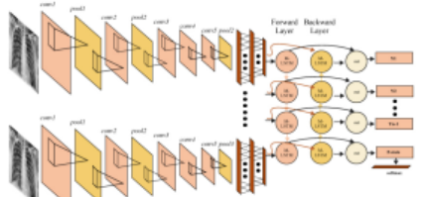
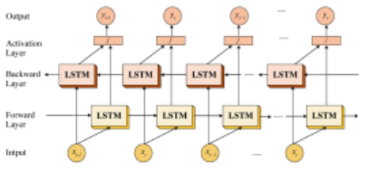
Methodology
Reference Model of Experimment 1
02
CNN-BiLSTM
14

Slide 15
Methodology
Reference models of Experiment 2
03
VGG19-LSTM
05
VGG16-BiLSTM
04
VGG16-LSTM
06
InceptionResNetV2
15

Slide 16
Methodology
Tools Used
Google Colab platform - used for training and testing
GPU - Tesla K80
Keras library of TensorFlow version 2.2.0 and python 3.8 - for model formation
16

Slide 17
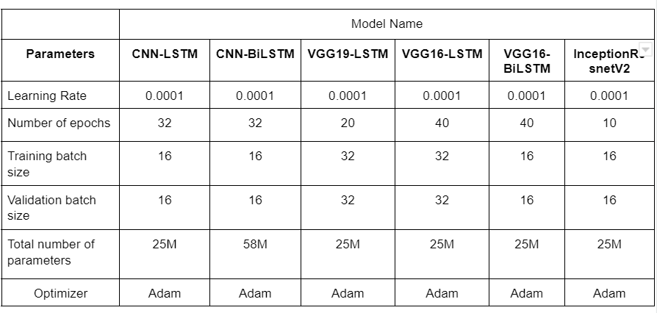
Methodology
Hyperparameter settings for the models
17

Slide 18
Result Analysis
18

Slide 19
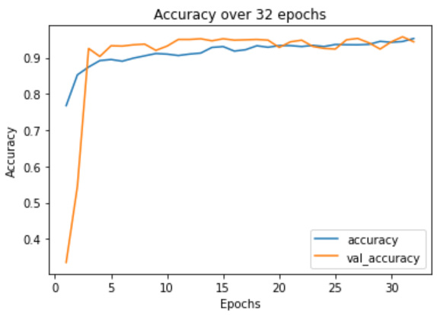
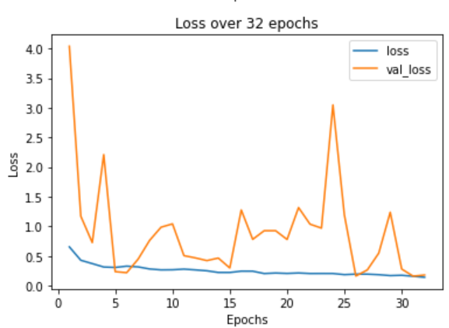
Result Analysis
CNN-LSTM : Dataset 1
x = number of epochs
y = accuracy
y = loss
left
right
Training and validation accuracy
Training and validation loss
19

Slide 20
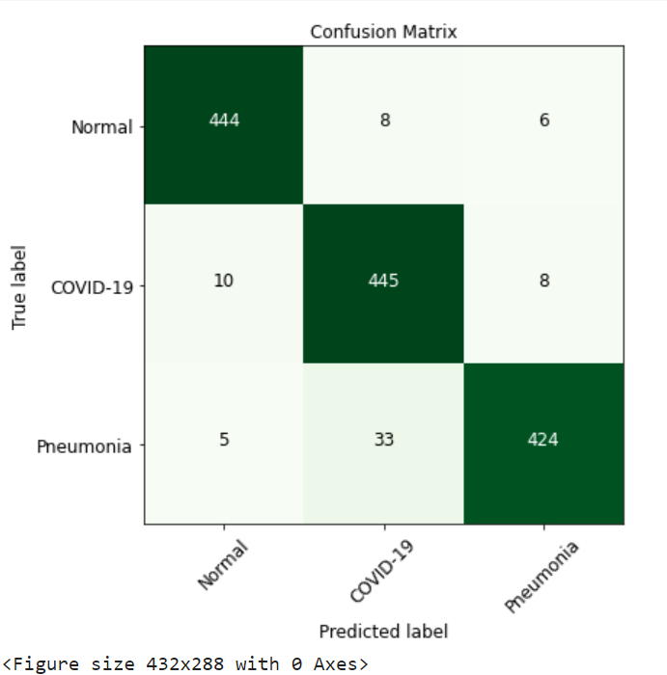
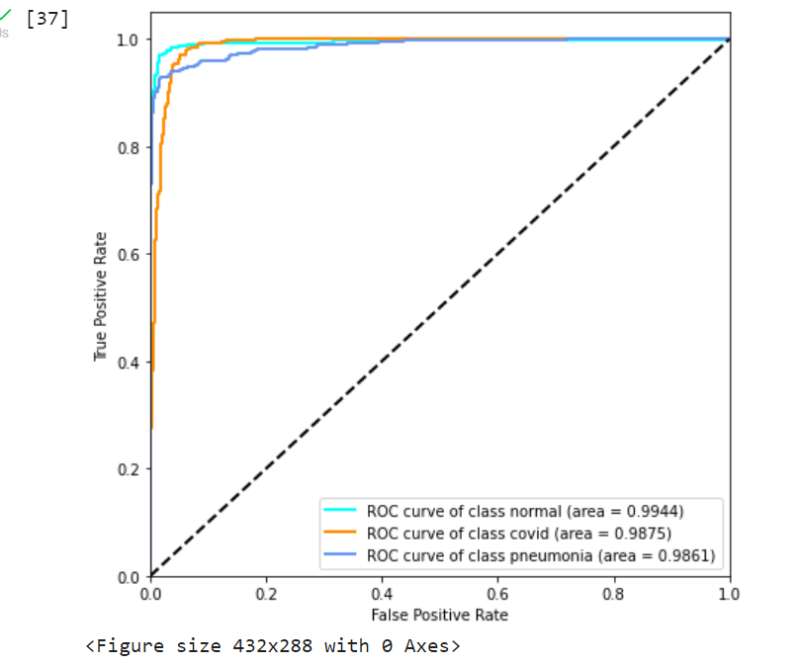
Result Analysis
CNN-LSTM : Dataset 1
Confusion Matrix
ROC curve
20

Slide 21
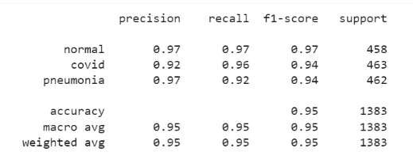
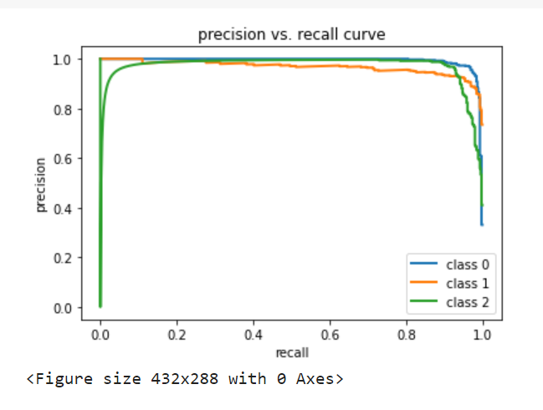
Result Analysis
CNN-LSTM : Dataset 1
Classification report
Precision vs Recall Curve
21

Slide 22
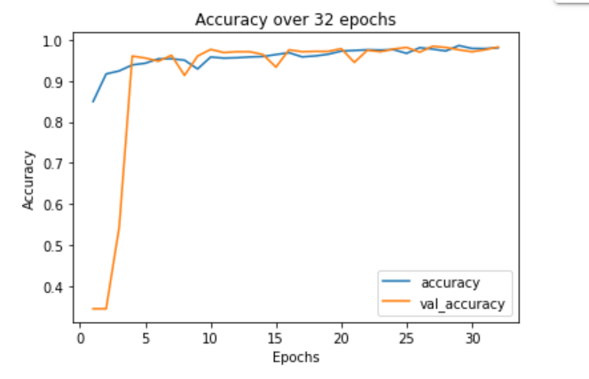
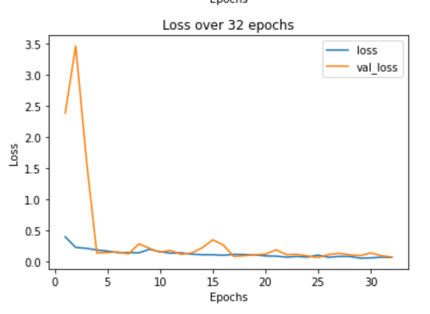
Result Analysis
CNN-LSTM : Dataset 2
x = number of epochs
y = accuracy
y = loss
left
right
Training and Validation accuracy
Training and validation loss
22

Slide 23
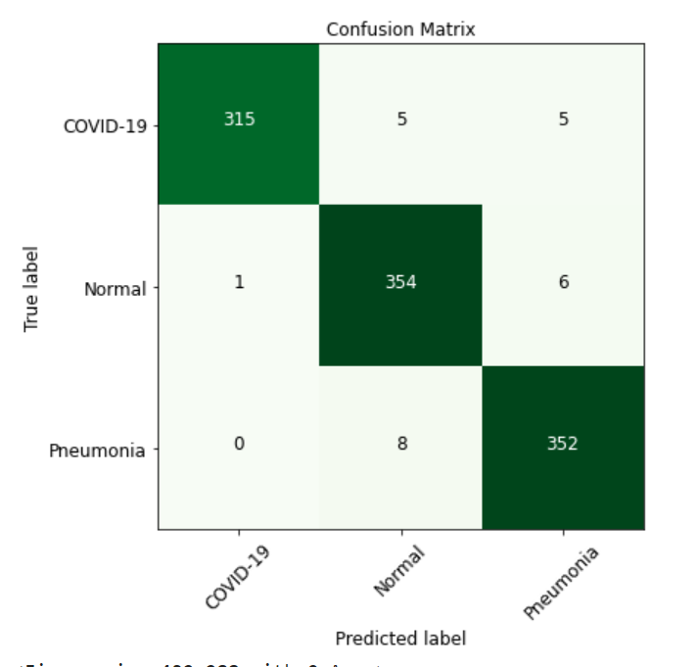
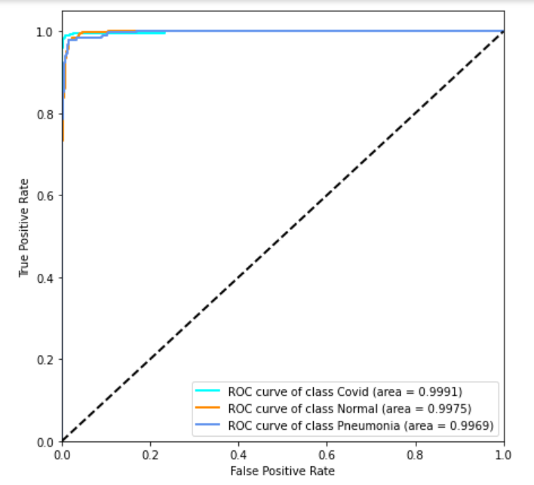
Result Analysis
CNN-LSTM : Dataset 2
Confusion Matrix
ROC curve
23

Slide 24
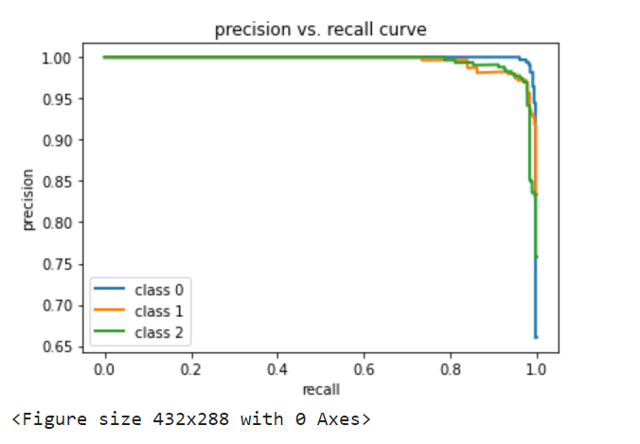
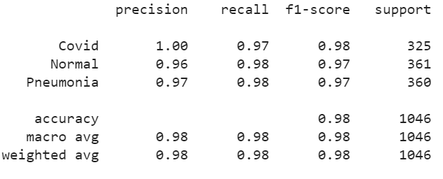
Result Analysis
CNN-LSTM : Dataset 2
Classification report
Precision vs Recall Curve
24

Slide 25
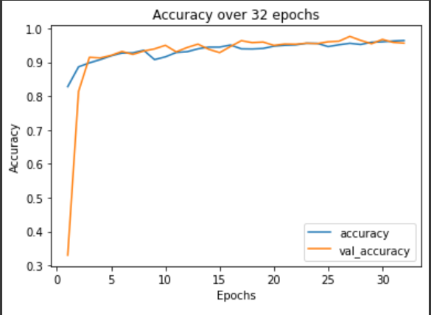
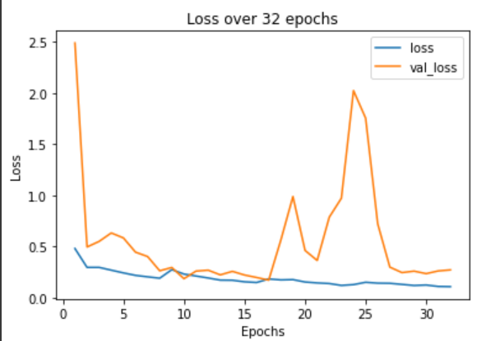
Result Analysis
CNN-BiLSTM : Dataset 1
x = number of epochs
y = accuracy
y = loss
left
right
Training and Validation accuracy
Training and validation loss
25

Slide 26
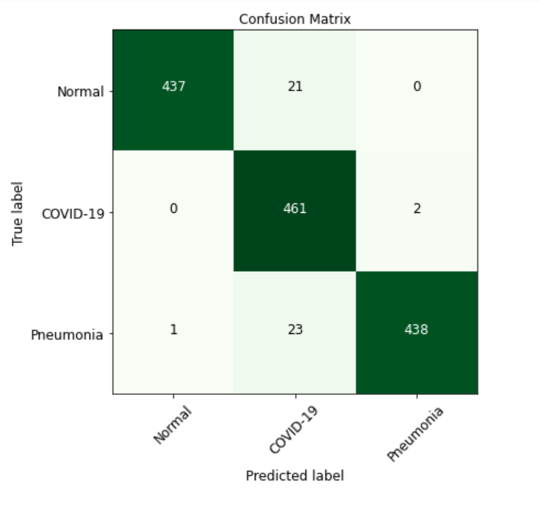
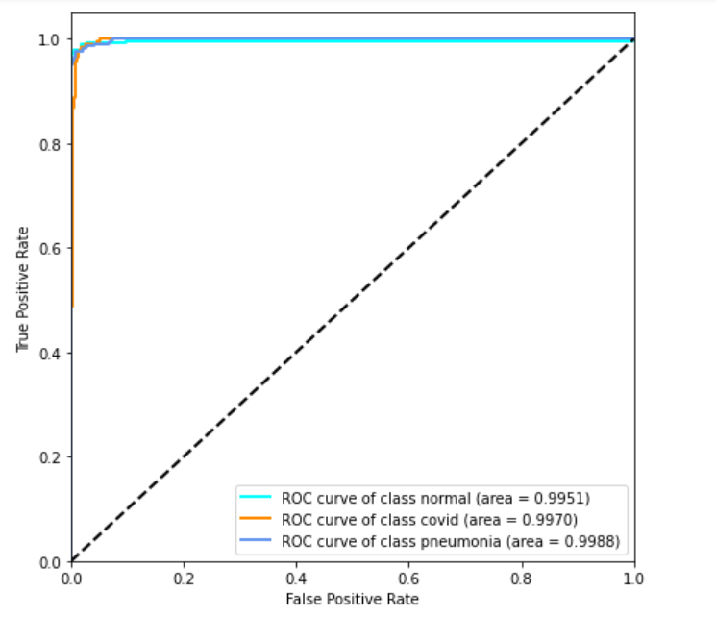
Result Analysis
CNN-BiLSTM : Dataset 1
Confusion Matrix
ROC curve
26

Slide 27
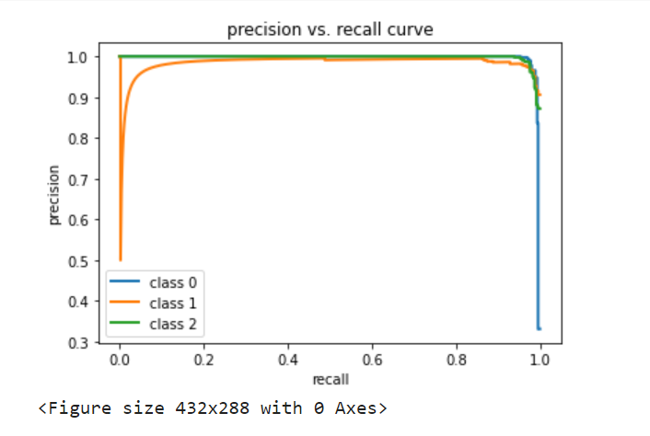
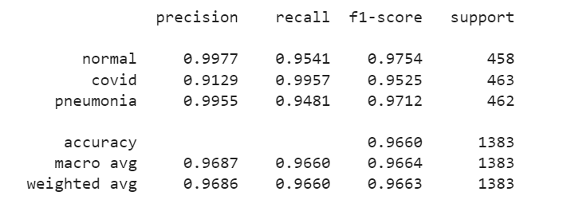
Result Analysis
CNN-BiLSTM : Dataset 1
Classification report
Precision vs Recall Curve
27

Slide 28
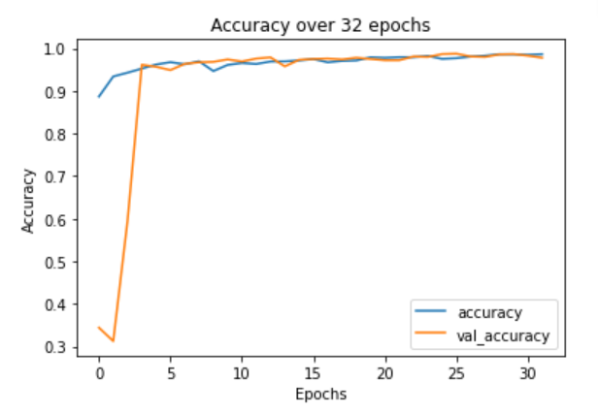
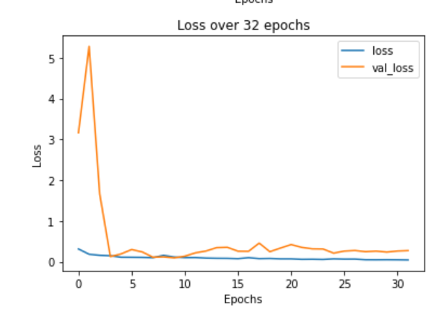
Result Analysis
CNN-BiLSTM : Dataset 2
x = number of epochs
y = accuracy
y = loss
left
right
Training and validation accuracy
Training and validation loss
28

Slide 29
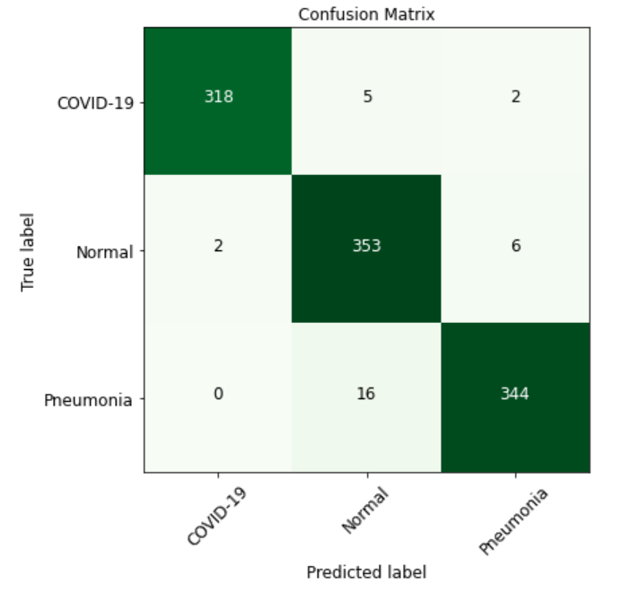
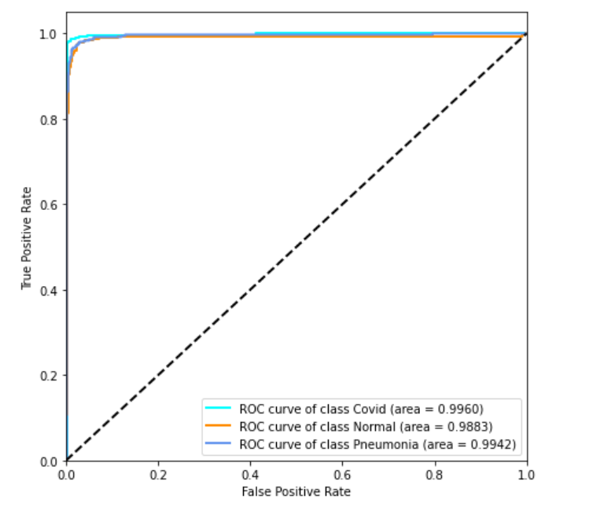
Result Analysis
CNN-BiLSTM : Dataset 2
Confusion Matrix
ROC curve
29

Slide 30
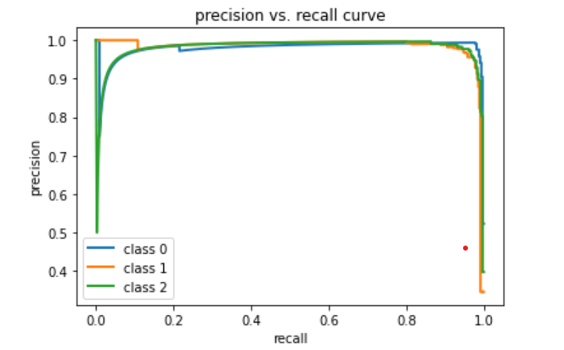
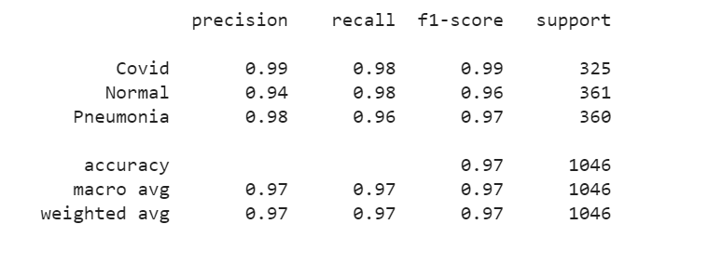
Result Analysis
CNN-BiLSTM : Dataset 2
Classification report
Precision vs Recall Curve
30

Slide 31
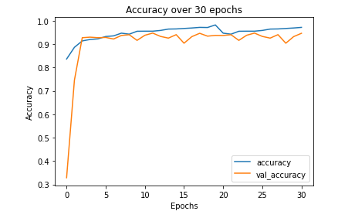
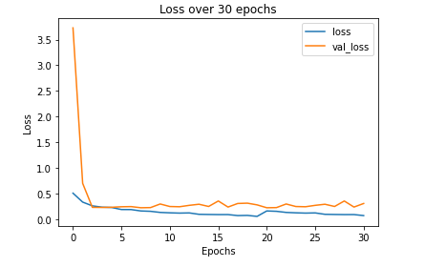
Result Analysis
VGG19-LSTM (Dataset 1)
x = number of epochs
y = accuracy
y = loss
left
right
Training and validation accuracy
Training and validation loss
31

Slide 32
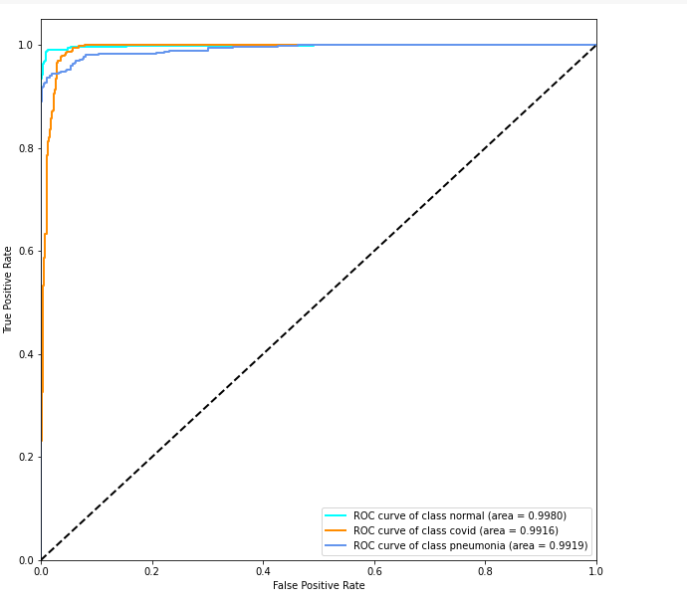
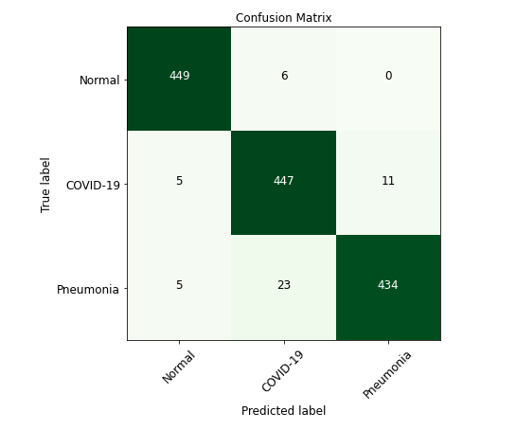
Result Analysis
VGG19-LSTM (Dataset 1)
Confusion Matrix
ROC curve
32

Slide 33
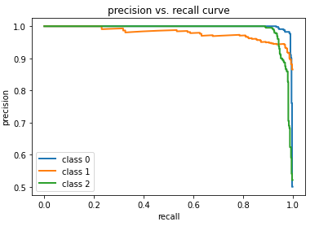
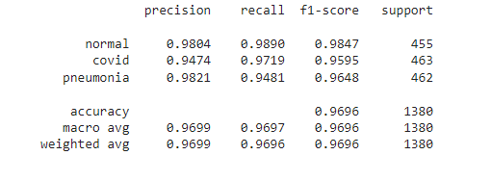
Result Analysis
VGG19-LSTM(Dataset 1)
Classification report
Precision vs Recall Curve
33

Slide 34
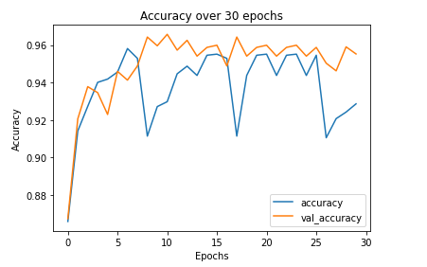
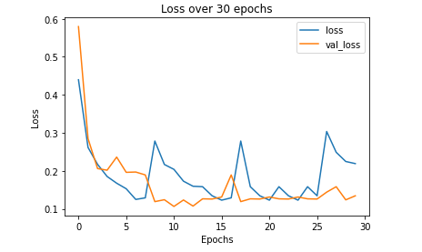
Result Analysis
VGG16-LSTM(Dataset 1)
x = number of epochs
y = accuracy
y = loss
left
right
Training and validation accuracy
Training and validation loss
34

Slide 35
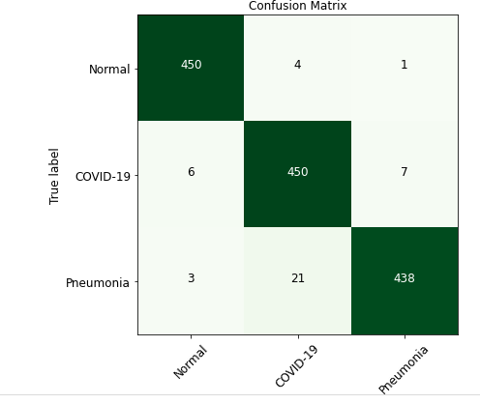
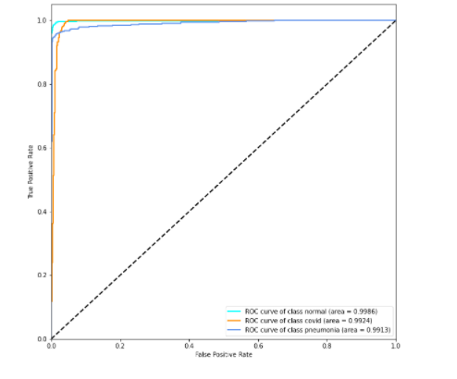
Result Analysis
VGG16-LSTM(Dataset 1)
Confusion Matrix
ROC curve
35

Slide 36
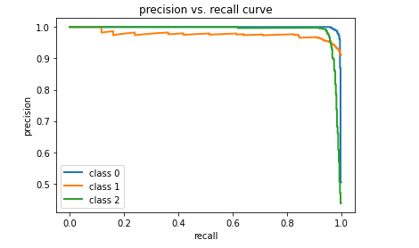
Result Analysis
VGG16-LSTM(Dataset 1)
Classification report
Precision vs Recall Curve
36

Slide 37
Result Analysis
VGG16-BiLSTM(Dataset 1)
x = number of epochs
y = accuracy
y = loss
left
right
Training and validation accuracy
Training and validation loss
37

Slide 38


Result Analysis
VGG16-BiLSTM(Dataset 1)
Confusion Matrix
ROC curve
38

Slide 39


Result Analysis
VGG16-BiLSTM(Dataset 1)
Classification report
Precision vs Recall Curve
39

Slide 40


Result Analysis
InceptionResNetV2-LSTM (Dataset 1)
x = number of epochs
y = accuracy
y = loss
left
right
Training and validation accuracy
Training and validation loss
40

Slide 41


Result Analysis
InceptionResNetV2-LSTM(Dataset 1)
Confusion Matrix
ROC curve
41

Slide 42


Result Analysis
InceptionResNetV2-LSTM(Dataset 1)
Classification report
Precision vs Recall Curve
42

Slide 43


Result Analysis
Time needed for training of the models
43

Slide 44


Result Analysis
Comparative Results and Discussions
Accuracy (%)
Precision (%)
Recall (%)
F1-score (%)
44

Slide 45

Result Analysis
Comparative Results and Discussions
Comparision with other papers
45

Slide 46

Future Direction
Increase the capability of our system by using more data
Generating larger datasets by synthetic data generation for unbalanced data
Explore more advanced pre-trained models
Use of advanced ensembling techniques
Getting devices capable of working with larger datasets
46

Slide 47

Conclusion
Taking all of the limitations and constraints in mind we have come up with the idea of our proposed system which is to detect covid19 using chest x ray images. We believe that our proposed system will go a long way in achieving this goal and will help doctors and medical personnel and will add a significant value to the medical field.
47

Slide 48
References
[1] wikipedia, “Covid-19 Pandemic.” https://en.wikipedia.org/wiki/ COVID-19_pandemic, 2020. [Online; accessed 24 Dec 2021].
[2] R. S. Kaplan and M. E. Porter, “How to solve the cost crisis in health care,” Harv Bus Rev, vol. 89, no. 9, pp. 46–52, 2011.
[3] M. Z. Islam, M. M. Islam, and A. Asraf, “A combined deep cnn-lstm network for the detection of novel coronavirus (covid-19) using x-ray images,” Informatics in medicine unlocked, vol. 20, p. 100412, 2020.
[4] Z. Mousavi, N. Shahini, S. Sheykhivand, S. Mojtahedi, and A. Arshadi, “Covid-19 de tection using chest x-ray images based on a developed deep neural network,” SLAS Technology, 2021.
[5] H. Naeem and A. A. Bin-Salem, “A cnn-lstm network with multi-level feature extraction-based approach for automated detection of coronavirus from ct scan and x-ray images,” Applied Soft Computing, vol. 113, p. 107918, 2021.
[6] K. Akyol and B. ¸Sen, “Automatic detection of covid-19 with bidirectional lstm net work using deep features extracted from chest x-ray images,” Interdisciplinary Sciences: Computational Life Sciences, pp. 1–12, 2021.
[7] F. A. Saiz and I. Barandiaran, “Covid-19 detection in chest x-ray images using a deep learning approach,” International Journal of Interactive Multimedia and Artificial Intel ligence, InPress (InPress), vol. 1, 2020.
[8] A. Bhattacharyya, D. Bhaik, S. Kumar, P. Thakur, R. Sharma, and R. B. Pachori, “A deep learning based approach for automatic detection of covid-19 cases using chest x-ray images,” Biomedical Signal Processing and Control, vol. 71, p. 103182, 2022.
[9] K. F. Haque, F. F. Haque, L. Gandy, and A. Abdelgawad, “Automatic detection of covid 19 from chest x-ray images with convolutional neural networks,” in 2020 Interna tional Conference on Computing, Electronics & Communications Engineering (iCCECE), pp. 125–130, IEEE, 2020.
[10] S. Hussain Khan, A. Sohail, and A. Khan, “Covid-19 detection in chest x-ray images using a new channel boosted cnn,” arXiv e-prints, pp. arXiv–2012, 2020.
[11] T. Gao, “Chest x-ray image analysis and classification for covid-19 pneumonia detec tion using deep cnn,” medRxiv, 2020.
[12] P. K. Sethy, S. K. Behera, P. K. Ratha, and P. Biswas, “Detection of coronavirus disease (covid-19) based on deep features and support vector machine,” 2020.
[13] A. Makris, I. Kontopoulos, and K. Tserpes, “Covid-19 detection from chest x-ray images using deep learning and convolutional neural networks,” in 11th Hellenic Conference on Artificial Intelligence, pp. 60–66, 2020.
[14] A. Abbas, M. M. Abdelsamea, and M. M. Gaber, “Classification of covid-19 in chest x-ray images using detrac deep convolutional neural network,” Applied Intelligence, vol. 51, no. 2, pp. 854–864, 2021.
[15] L. Wang, Z. Q. Lin, and A. Wong, “Covid-net: A tailored deep convolutional neural network design for detection of covid-19 cases from chest x-ray images,” Scientific Reports, vol. 10, no. 1, pp. 1–12, 2020.
[16] B. Sekeroglu and I. Ozsahin, “covid19 detection of covid-19 from chest x-ray images using convolutional neural networks,” SLAS TECHNOLOGY: Translating Life Sciences Innovation, vol. 25, no. 6, pp. 553–565, 2020.
[17] X. P. Burgos-Artizzu, “Automated covid-19 detection from frontal chest x-ray images using deep learning: an online feasibility study,” medRxiv, 2020.
[18] A. K. Das, S. Ghosh, S. Thunder, R. Dutta, S. Agarwal, and A. Chakrabarti, “Automatic covid-19 detection from x-ray images using ensemble learning with convolutional neu ral network,” Pattern Analysis and Applications, pp. 1–14, 2021.
48

Slide 49
References
[19] Ç. Polat, O. Karaman, C. Karaman, G. Korkmaz, M. C. Balcí, and S. E. Kelek, “Covid-19 diagnosis from chest x-ray images using transfer learning: Enhanced performance by debiasing dataloader,” Journal of X-Ray Science and Technology, no. Preprint, pp. 1–18.
[20] S. Sakib, M. A. B. Siddique, M. M. R. Khan, N. Yasmin, A. Aziz, M. Chowdhury, and I. K. Tasawar, “Detection of covid-19 disease from chest x-ray images: A deep transfer learning framework,” medRxiv, 2020.
[21] M. S. Al-Rakhami, M. M. Islam, M. Z. Islam, A. Asraf, A. H. Sodhro, and W. Ding, “Diagnosis of covid-19 from x-rays using combined cnn-rnn architecture with transfer learning,” MedRxiv, pp. 2020–08, 2021.
[22] S. Akter, F. Shamrat, S. Chakraborty, A. Karim, and S. Azam, “Covid-19 detection using deep learning algorithm on chest x-ray images,” Biology, vol. 10, no. 11, p. 1174, 2021.
[23] W. Kusakunniran, S. Karnjanapreechakorn, T. Siriapisith, P. Borwarnginn, K. Sutas sananon, T. Tongdee, and P. Saiviroonporn, “Covid-19 detection and heatmap generation in chest x-ray images,” Journal of Medical Imaging, vol. 8, no. S1, p. 014001, 2021.
[24] A. Narin, C. Kaya, and Z. Pamuk, “Automatic detection of coronavirus disease (covid 19) using x-ray images and deep convolutional neural networks. arxiv 2020,” arXiv preprint arXiv:2003.10849, 2003.
[25] S. Ahmed, T. Hossain, O. B. Hoque, S. Sarker, S. Rahman, and F. M. Shah, “Automated covid-19 detection from chest x-ray images: A high-resolution network (hrnet) ap proach,” SN computer science, vol. 2, no. 4, pp. 1–17, 2021.
[26] R. Kumar, A. Arora, B. Bansal, V. Sahayasheela, H. Buckchash, J. Imran, N. Narayanan, G. Pandian, and B. Raman, “Accurate prediction of covid-19 using chest x-ray images through deep feature learning model with smote and machine learning classifiers. medrxiv 2020.04. 13.20063461.”
[27] D. Singh, V. Kumar, V. Yadav, and M. Kaur, “Deep neural network-based screening model for covid-19-infected patients using chest x-ray images,” International Journal of Pattern Recognition and Artificial Intelligence, vol. 35, no. 03, p. 2151004, 2021.
[28] T. Ozturk, M. Talo, E. A. Yildirim, U. B. Baloglu, O. Yildirim, and U. R. Acharya, “Au tomated detection of covid-19 cases using deep neural networks with x-ray images,” Computers in biology and medicine, vol. 121, p. 103792, 2020.
[29] S. D. Deb and R. K. Jha, “Covid-19 detection from chest x-ray images using ensemble of cnn models,” in 2020 International Conference on Power, Instrumentation, Control and Computing (PICC), pp. 1–5, IEEE, 2020.
[30] T. B. Chandra, K. Verma, B. K. Singh, D. Jain, and S. S. Netam, “Coronavirus disease (covid-19) detection in chest x-ray images using majority voting based classifier en semble,” Expert systems with applications, vol. 165, p. 113909, 2021.
[31] M. Abdul Salam, S. Taha, and M. Ramadan, “Covid-19 detection using federated ma chine learning,” Plos one, vol. 16, no. 6, p. e0252573, 2021.
[32] H. A. Kaheel H and C. A, “AI-Based Image Processing for COVID-19 Detection in Chest CT Scan Images,” frontiersin, vol. 02, no. 12, p. 645040, 2021.
[33] A. Asraf, “Covid19_pneumonia_normal_chest_xray_pa_dataset.” https://www.kaggle.com/amanullahasraf/
covid19-pneumonia-normal-chest-xray-pa-dataset, 2020. [Online; accessed November 2021].
[34] S. Kumar, “Covid19 + pneumonia + normal chest x-ray im ages.” https://www.kaggle.com/sachinkumar413/ covid-pneumonia-normal-chest-xray-images, 2021. [Online; accessed November 2021].
49

Slide 50

Thank You
50

